Slide 1
Quiz on Lecture 1
Please receive the quiz handout from Cyrille, Oliver, Vincent, Jan
Complete the quiz in silence
Hand the quiz back

Slide 2
Quiz on Lecture 1
What is Oliver's favourite animal?
  Cats
  Dogs
  Dolphins
  Rats
What is Vincent's nickname?
  Terminator
  Mr API
  Chicken Man
  The Bulldozer
How important are mathematics skills in this course?
  Essential
  High
  Medium
  Almost irrelevant
Where will you do your coding in this course?
  VS Code
  Cursor
  Pycharm
  VS Code within Github Codespaces
All apps you build will be deployed where?
  Google Cloud Run
  AWS App Runner
  Google Artifact Registry
  Locally on AIMS servers
What is the term used to describe Infrastructure Provisioning, when it's done in a manual way?
  MLOps
  IaC (Infrastructure as Code)
  ClickOps
  SaaS (Software as a Service)

Slide 3
Quiz on Lecture 1 (Answers)
What is Oliver's favourite animal?
  Cats
  Dogs
  Dolphins
  Rats
What is Vincent's nickname?
  Terminator
  Mr API
  Chicken Man
  Bulldozer
How important are mathematics skills in this course?
  Essential
  High
  Medium
  Almost irrelevant
Where will you do your coding in this course?
  VS Code
  Cursor
  Pycharm
  VS Code within Github Codespaces
All apps you build will be deployed where?
  Google Cloud Run
  AWS App Runner
  Google Artifact Registry
  Locally on AIMS servers
What is the term used to describe Infrastructure Provisioning, when it's done in a manual way?
  MLOps
  IaC (Infrastructure as Code)
  ClickOps
  SaaS (Software as a Service)

Slide 4
Designing and Deploying
end-to-end
Production Grade ML Applications
Lecture 2: Containers; RESTful APIs; & Microservices
October 2025
Oliver Angélil & Vincent Frimpong

Slide 5
Contents of this lecture
Containers (Introduction & Docker)
RESTful APIs
OpenAPI
FastAPI
Microservices
The Synergy: How they all work together
Example Architecture Diagram
Conclusion & Key Takeaways
Q & A
Oliver

Slide 6
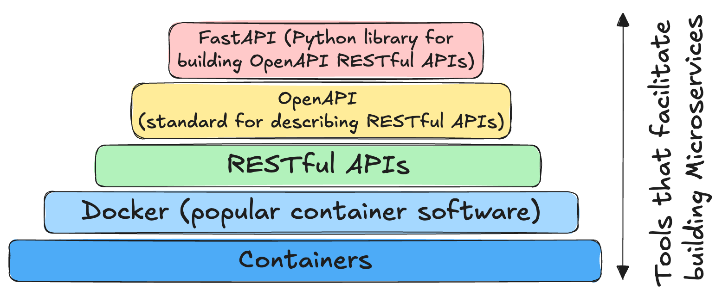
This lecture in one diagram
Oliver

Slide 7
1. Containers: Introduction
Developer: "Hey, I just finished the new feature. It works perfectly on my machine!"
Tester: “Great! Let’s deploy it and see how it goes.”
[Later]
Tester: “Uh, the application is failing. It’s throwing errors everywhere.”
Developer: “That’s strange. It worked fine here. Did you try turning your computer off and on again?”
Tester: “Yes, and it’s missing some dependencies and there are version conflicts. It’s like it’s a completely different environment!”
Developer: “Well, it works on my machine!”
Problem -> "Well, it works on my machine"
Solution -> Containers
Oliver

Slide 8
1. Containers: What is a Container?
A container packages up code and all its dependencies so the application runs quickly and reliably from one computing environment to another.
Examples of popular docker container images:
mysql
postgres
nginx
python
node
php
In other words, any software can be packaged into a container! It is like a virtual machine but much lighter. It does not virtualize the entire operating system, just the software layers above the OS.
See dockerhub for more examples of container images
Oliver

Slide 9
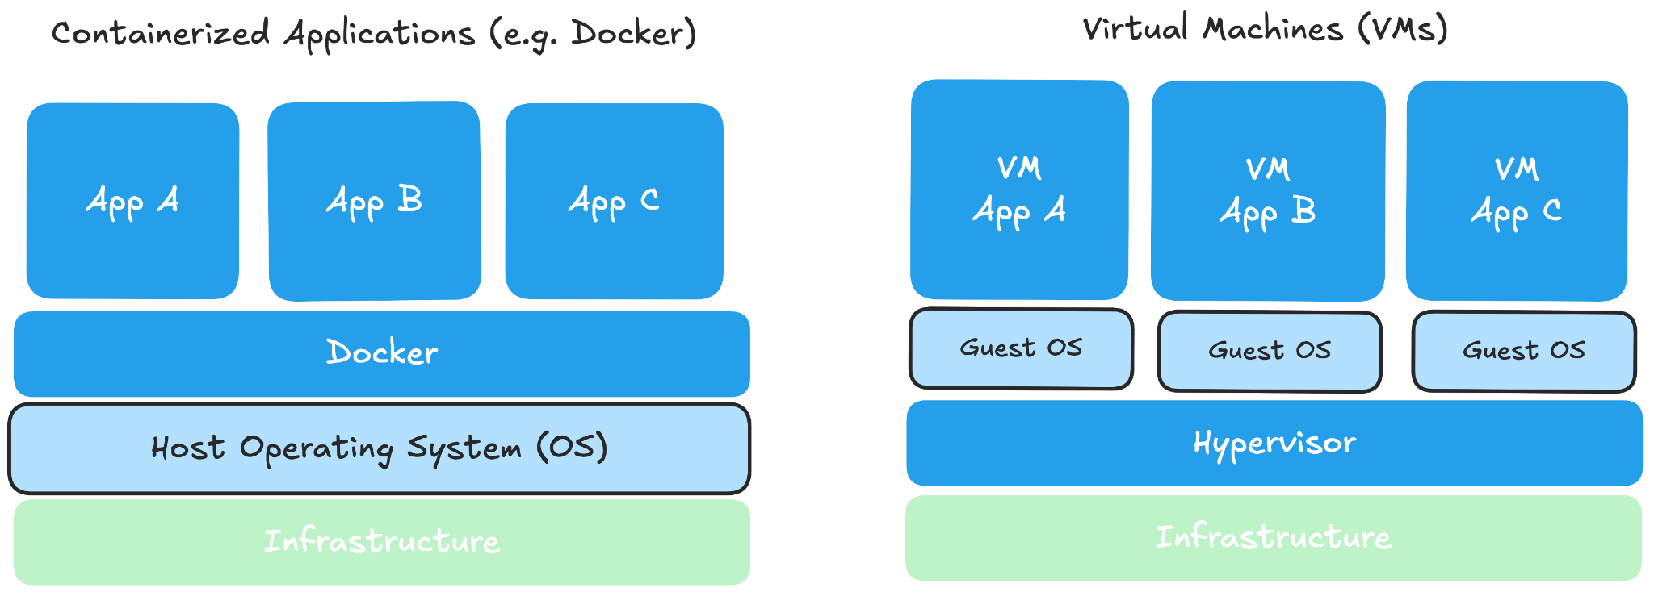
1. Containers: Docker
Platform for developing, shipping, and running applications using containerization.
Packages application code with all its dependencies (libraries, runtime, tools) into a container.
Contrast with Virtual Machines:
Oliver

Slide 10
1. Containers: Docker Benefits
Consistency: "Works on my machine" problem solved. Same environment from dev to production.
Isolation: Containers run isolated from each other and the host OS (can have multiple on one OS)
Resource Efficiency: Lighter weight than VMs (faster start, less overhead).
Portability: Run anywhere Docker is installed (local, cloud, data center).
Rapid Deployment: Spin up/down containers quickly.
Simplification: Simplifies Dependency Management.
Oliver

Slide 11
1. Containers: Key Components of Docker
Container Image: Read-only file containing application code and dependencies (docker build)
Container: Runnable instance of an image (docker run)
Dockerfile: Text file with instructions to build a Docker image.
Registry (e.g., Docker Hub; Google Artifact Registry): Storage and distribution for Docker images.
Docker Compose (optional): File for defining and running multi-container Docker applications.
Oliver

Slide 12
1. Containers: Dockerfile
See complete github file here
# specify the base image for the build.
FROM python:3.12.9-slim
# copy the uv and uvx executables from the uv image
# into the /bin/ directory of the current image
COPY --from=ghcr.io/astral-sh/uv:latest /uv /uvx /bin/
# sets the working directory inside the container to /app
WORKDIR /app
# copies all files and directories from the build context into the app
COPY . .
# this command will install the project packages listed in pyproject.toml
RUN uv sync --frozen
# Expose the port your application uses
EXPOSE 8080
# Use the entrypoint script to select the API
ENTRYPOINT ["/app/entrypoint.sh"]
Oliver

Slide 13
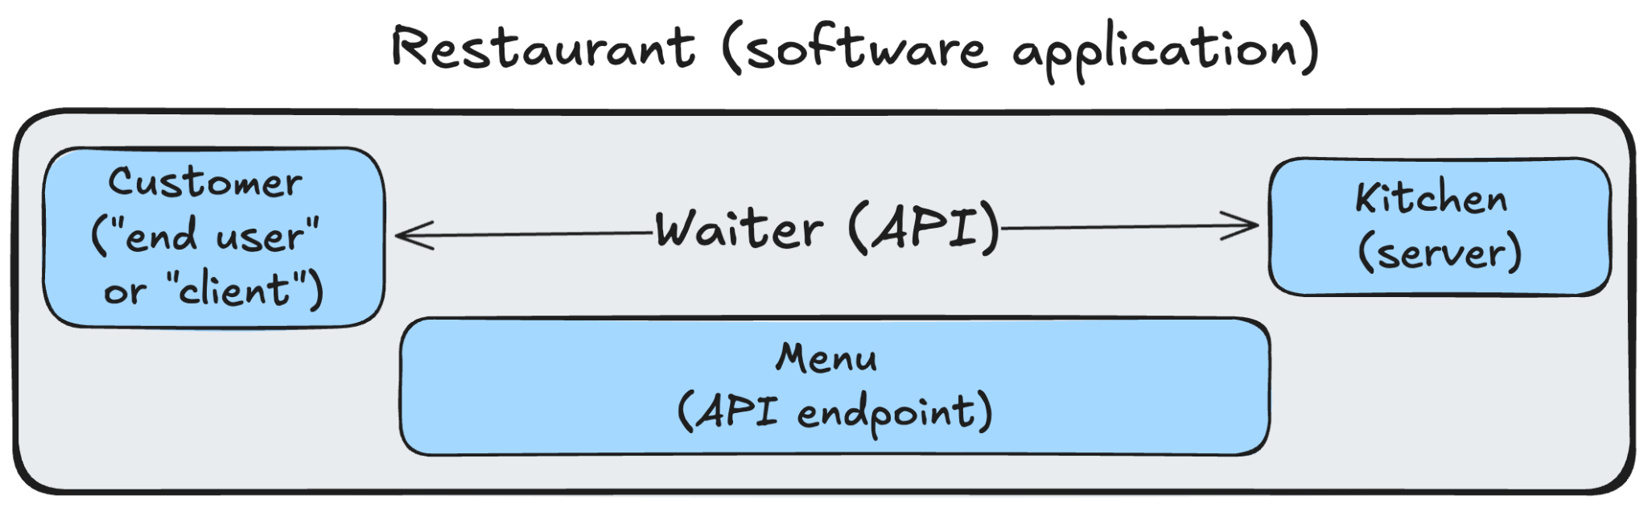
2. RESTful APIs: What is an API? What is REST?
API (Application Programming Interface): A contract defining how software components interact.
REST (REpresentational State Transfer): A set of rules/standards for how to build a specific type of API.
A Restaurant Analogy: Like a menu in a restaurant (API) and the standard way waiters take orders (REST principles) — because waiters have many ways of taking orders: memorize; write-down; use an iPad; etc.
Vincent

Slide 14
2. RESTful APIs: Key Principles/Concepts of REST
Resources: Everything is a resource (e.g., /users, /orders/123). Identified by Uniform Resource Identifiers (URIs).
Standard HTTP Methods:
GET: Retrieve data.
POST: Send data to a server to insert a resource.
PUT: Send data to a server to insert/update a resource (idempotent; when you know the URL)
DELETE: Remove data.
Representations: Data format (e.g., JSON, HTML, XML). JSON is most popular.
Stateless Communication: Server holds no client state between requests (each request is separate and unconnected).
Uniform Interface: Consistent way of interacting with resources.
Vincent

Slide 15
2. RESTful APIs: Benefits
Simplicity & Standardization: Built on standard HTTP methods (GET, POST, PUT, DELETE).
Statelessness: No client information is stored between get requests and each request is separate and unconnected.
Performance: Can leverage HTTP caching mechanisms. Caching is easily supported. Clients or intermediate proxies can store these responses, reducing the need to contact the server repeatedly for the same data
Decoupling: The separation between the client and the server is a core principle. The client only needs to know the URI of the resource.
Interoperability: Because REST relies on standard protocols (HTTP) and common data formats (like JSON, XML), clients and servers can be implemented in different programming languages and run on different platforms and operating systems, yet still communicate effectively.
Vincent

Slide 16
3. OpenAPI: What is OpenAPI?
Standard Specification: A widely adopted, open standard for defining and describing RESTful APIs.
Language-Agnostic: Describes the API's structure and capabilities regardless of the programming language used to build it (e.g. FastAPI with Python; Laravel with PHP; NestJS with TypeScript)
Defines API Contract: Clearly outlines available endpoints, operations (GET, POST, PUT, DELETE), parameters, request/response formats, authentication methods, and other essential details.
Machine & Human Readable: Written in formats (JSON or YAML) easily understood by both computers and developers.
Vincent

Slide 17
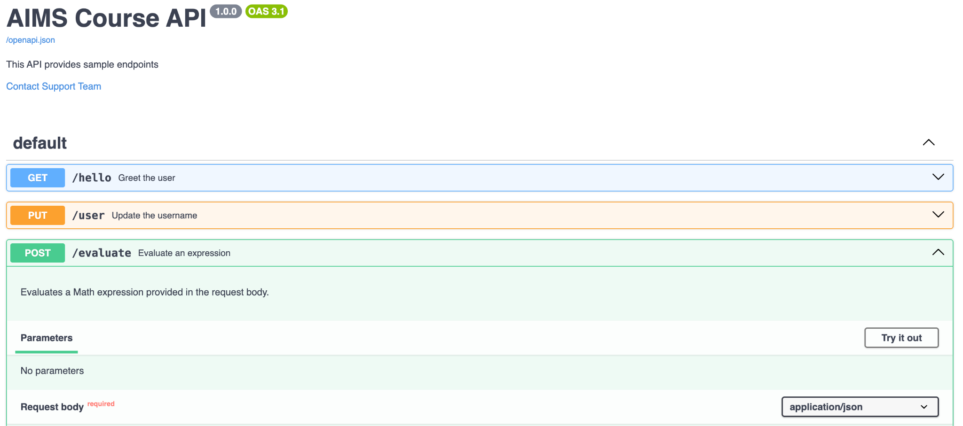
3. OpenAPI: What is OpenAPI?
Specification in OpenAPI JSON is used to generate such an HTML page:
Vincent

Slide 18
4. FastAPI: What is FastAPI?
A modern, fast (high-performance), web framework for building APIs with Python, that follows the OpenAPI standard
How to build an API in Python (see complete github file here):
from fastapi import FastAPI
# Create an instance of the FastAPI class - the main point of interaction to create for your API.
app = FastAPI()
# Define a path operation decorator
# This tells FastAPI that the function below is in charge of handling a GET requests that go to path "/"
@app.get("/")
async def read_root():
return {"Hello": "World"} # This is the root endpoint of the API. It returns a simple JSON response.
Run the app in github codespaces terminal: fastapi dev path/to/file.py
Vincent

Slide 19
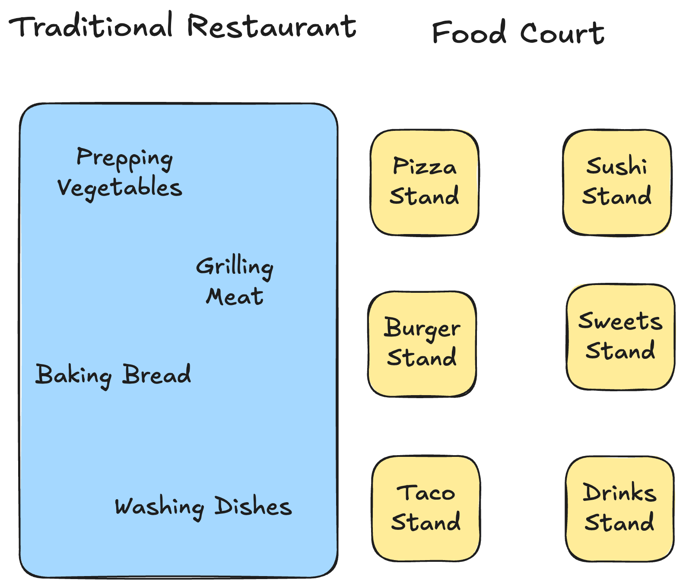
5. Microservices: Traditional Restaurant versus Food Court
Kitchen is a single large unit: all chefs work in the same space must coordinate closely
If grill station or oven breaks, entire kitchen is slowed down
Adding a new type of cuisine (e.g. sushi) is difficult because it requires changing the layout of the restaurant
Scaling means building a much bigger kitchen and hiring more staff for all roles, even if only the appetizer station is busy.
Each stall is a microservice with a specific business capability.
The pizza stall has its own staff, ovens, and ingredients
Customers interact with each stall via its counter.
If the pizza stall gets very busy, you can add more pizza ovens or staff just to that stall (independent scaling)
If the taco stall closes for the day (service failure), customers can still get pizza and sushi (fault isolation)
Vincent

Slide 20
5. Microservices: Restaurant analogy to Monoliths
The single large kitchen → single codebase and single deployable unit
All functions (prep, grill, bake) happening together → represents how different modules often share memory and resources directly.
Critical equipment failure halts the kitchen → illustrates the concept of a single point of failure. A severe bug, memory leak, or resource exhaustion in one component can potentially crash the entire application
Changing the menu requires kitchen adjustments → This corresponds to deployment. Any code change, requires rebuilding, retesting, and redeploying the entire application.
Scaling requires a bigger kitchen → If one feature (e.g., product search) becomes a bottleneck, you typically have to deploy more instances of the entire application, consuming resources for all the other features as well, even if they aren't under heavy load.
Vincent

Slide 21
5. Food court analogy to Microservices
Independent, specialized stalls (pizza, tacos, etc) → Each microservice is focused on a specific business capability (e.g. payment service, inventory service, etc) and is a separate deployable unit
Stalls Operate Independently → Illustrates loose coupling. The Pizza service doesn't need to know the implementation details of the Taco service. They communicate through interfaces (APIs)
Scaling just the busy stall (e.g., add pizza ovens) → Represents independent scaling. If the Inventory Service is under heavy load, you can deploy more instances of just the Inventory Service without scaling the others
Updating/Adding a stall independently → Corresponds to independent deployment. A new version of the Notification Service can be deployed on its own schedule without requiring the redeployment of other services
One stall closing doesn't close the food court → This illustrates fault isolation. If the Notification Service fails, users might still be able to manage inventory and process payments; the entire system doesn't necessarily go down
Vincent

Slide 22
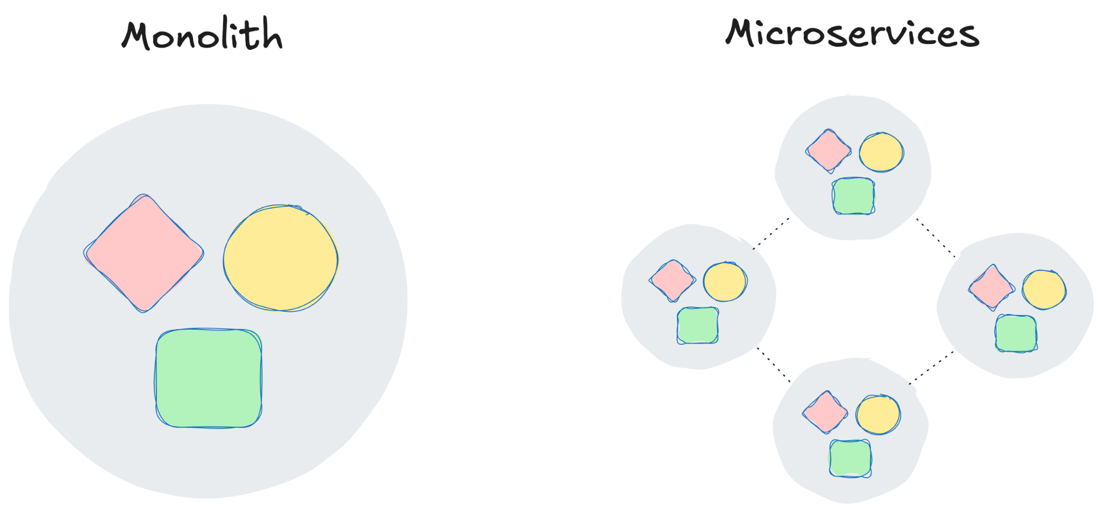
5. What are Microservices?
An architectural style structuring an application as a collection of loosely coupled, independently deployable services (e.g. docker containers).
Each service modeled around specific business functions (each service is often owned by a single small team).
Independently developed (decentralized governance, technology diversity), deployed, and scaled
Vincent

Slide 23
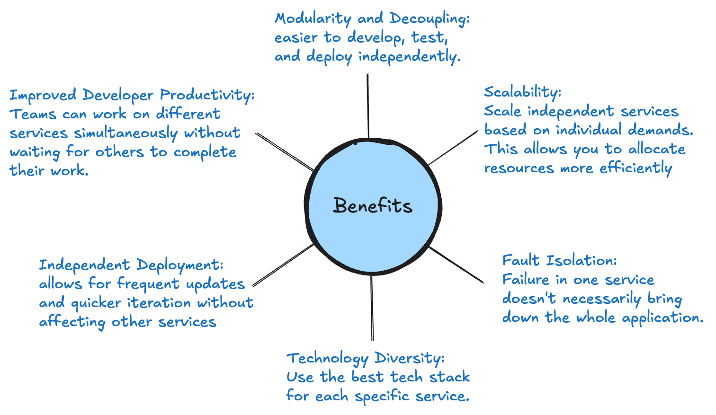
5. Microservices: Benefits
Vincent

Slide 24
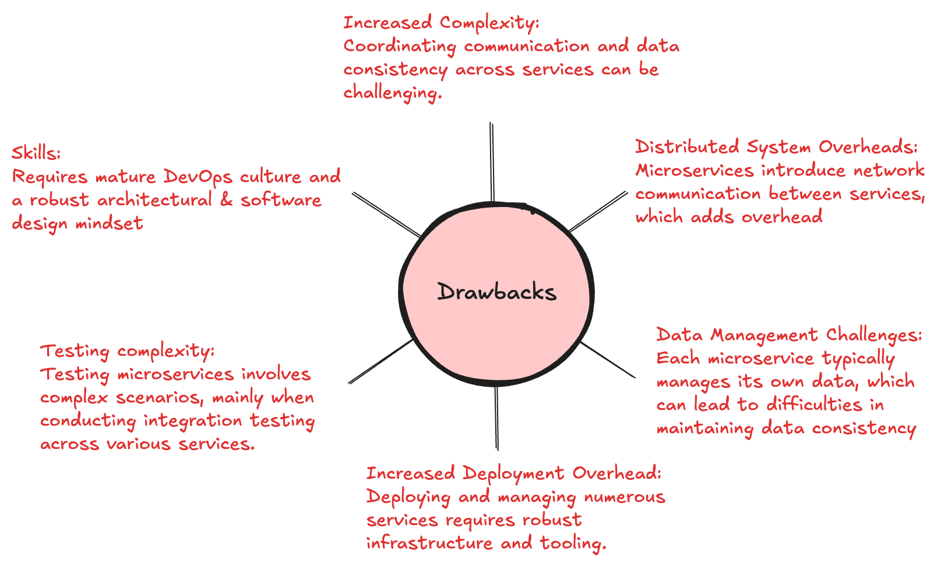
5. Microservices: Drawbacks
Vincent

Slide 25
5. Microservices: Microservices or Monoliths?
How choose between them? Start with a "monolith" in a docker container. Extend it to multiple services as the project grows, ensuring each service tackles a specific problem.
For example:
  Imagine your initial monolith handles user authentication, product catalog management, order processing, and payment gateway integration.
  As the application grows, you might observe that the order processing logic is becoming increasingly complex and requires independent scaling.
  Instead of rewriting the entire application, you can refactor the order processing module into a separate service and package it in its own Docker container.
  The original monolith can then communicate with this new "Order Service" container via internal network calls (e.g., REST APIs, gRPC, or a message queue).
  and so on, until you have many Microservices
Vincent

Slide 26
6. The Synergy: Docker in a Microservices World
Ideal for packaging individual microservices.
Each microservice runs in its own container..
Ensures consistent runtime environment for each service, regardless of underlying infrastructure.
Simplifies deployment and scaling of services.
Vincent

Slide 27
5. The Synergy: How They All Work Together
Microservices: Define the application's structure (small, independent services).
RESTful APIs: Define the communication mechanism between these services.
Docker: Provides the packaging and runtime environment for each service.
Together they enable building modular, scalable, independently deployable applications.
Vincent

Slide 28
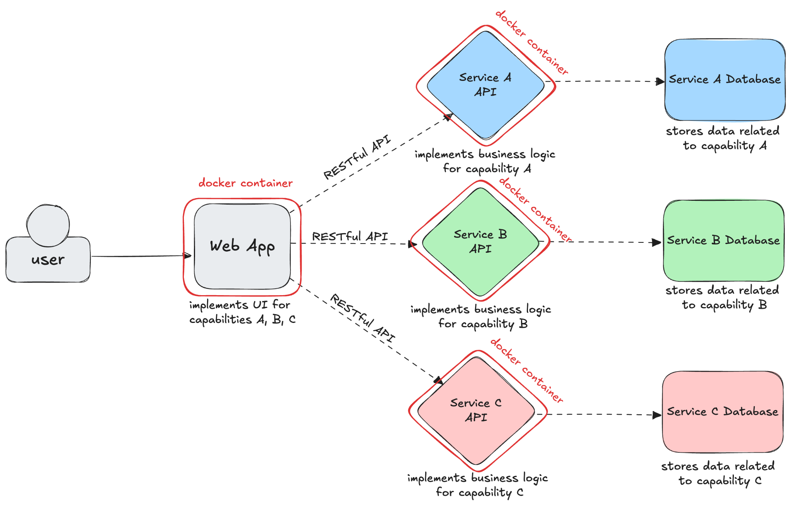
7. Example Architecture Diagram
Modular, Scalable, and Independently Deployable Application
e.g. customer orders (creating orders, status tracking)
e.g. product catalog (product name, description, price)
e.g. user authentication managing user accounts
Oliver

Slide 29
8. Conclusion & Key Takeaways
Containers (with Docker), RESTful APIs, and Microservices are powerful tools for modern application development.
They address challenges of monolithic architectures, promoting agility, scalability, and resilience.
Microservices structure the app architecture; REST APIs enable communication; Docker packages and runs the services
Oliver

Slide 30
9. Q&A
"Questions?"

